Slide 1
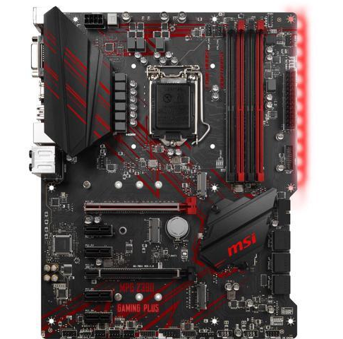
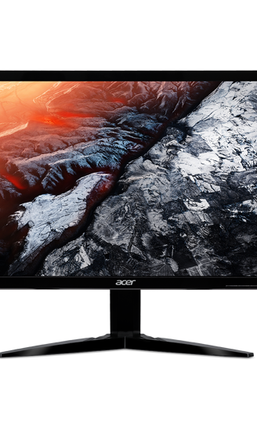
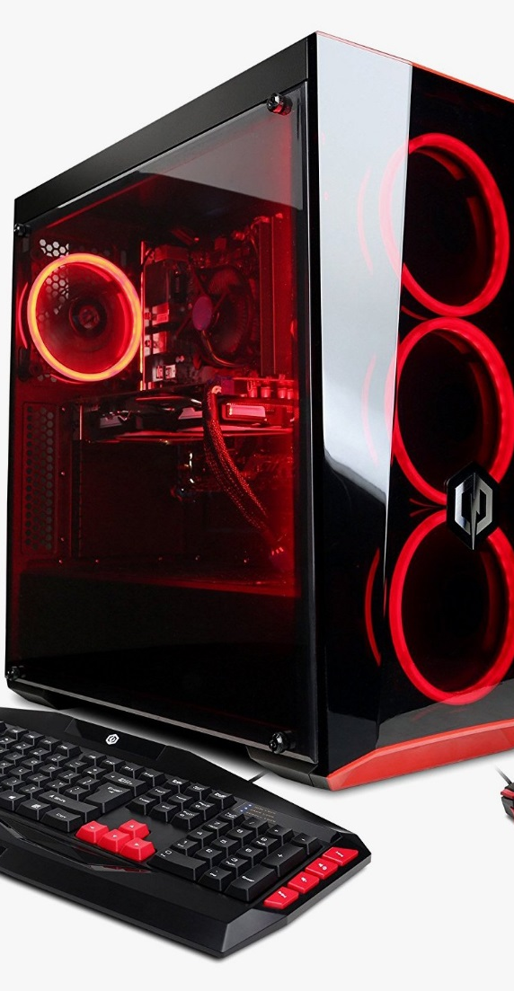
Dream Machine
Harkirat Mann
i5-9600k……………………$349.00 MSI MPG Z390…………...$184.99 Corsair Vengeance……….$139.99 WD Blue 1TB…………….....$57.99 Acer KG215Q…………..…$145.99 EVGA GTX 1660 T……….$379.00 10FT Ethernet Cable….…….$9.99 Mouse……………………….$22.99 Mechanical Keyboard……...$41.99 Hyper 212 EVO cooler…….$39.99 Total……………………....$1361.83
My dream machine would cost $1,361.83 CAD before tax. My costs are necessary because I want to run games at 144 frames per second at 1080p and in order to achieve that consistently I need a powerful CPU and GPU. Gamers want to experience a game in high quality without slowdown and are willing to pay a premium for a better experience, so I think the price is decent.

Slide 2
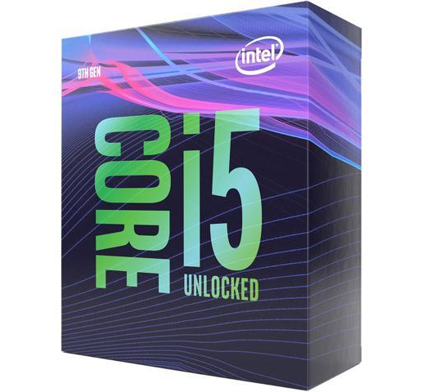
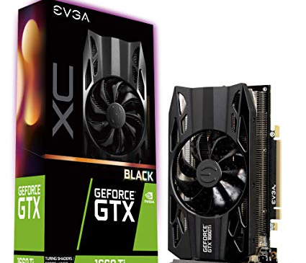
Parts chosen
For my CPU I chose the Intel Core i5 9600k. The Motherboard I chose was the MSI MPG Z390. I decided on Corsair Vengeance 16GB DDR4 RAM. The Hard Drive I chose was a WD Blue 1TB. The monitor I chose was the Acer KG215Q. The Graphics Card I chose was the EVGA NVIDIA GEFORCE GTX 1660 TI. The Network Interface I chose was a 10FT Ethernet Cable.
Why they were Chosen
I chose an Intel Core i5 9600k because it has many cores and a high clock speed which is necessary for gaming at a high frame rate. It can be overclocked for further performance. My Motherboard was chosen so I could overclock my processor. I got 16GB of RAM so I could play newer games and browse the internet while playing. The Hard Drive was 1TB so I could store a decent amount of games. The monitor has a 144hz refresh rate so I could play at 144 frames per second. The 1660 Ti was chosen so I could play at high settings, at 1080p and 144 frames per second at an affordable price point. I chose Ethernet because it’s faster than Wi-Fi and I need a good connection to play online.
Task
My task is to create a PC to play video games. In order to do this I need powerful parts that can create a good experience while playing video games.

